Slide 1
Jadhav Store order data analysis

Slide 2
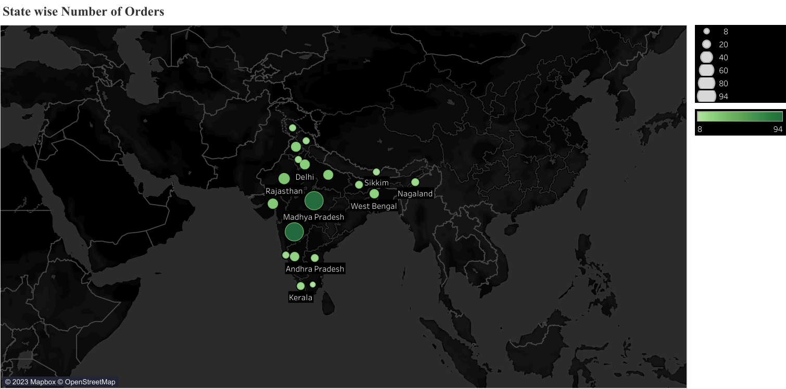

Slide 3
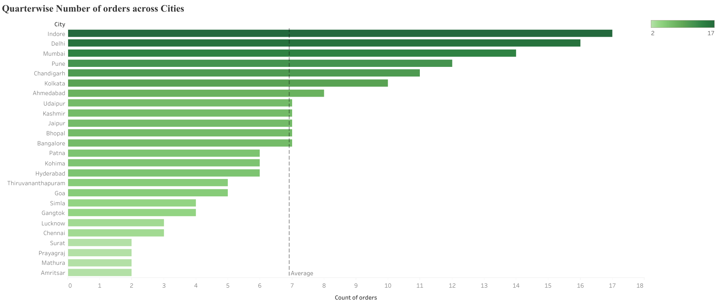

Slide 4
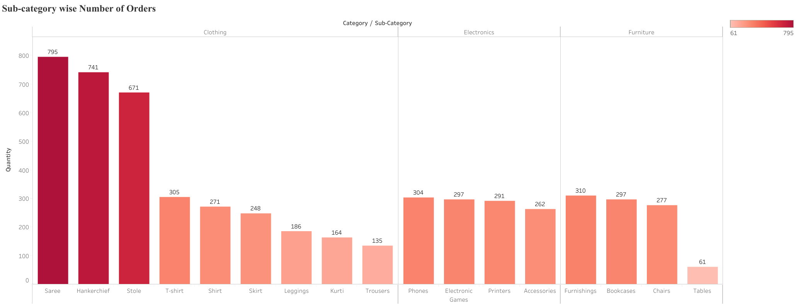

Slide 5
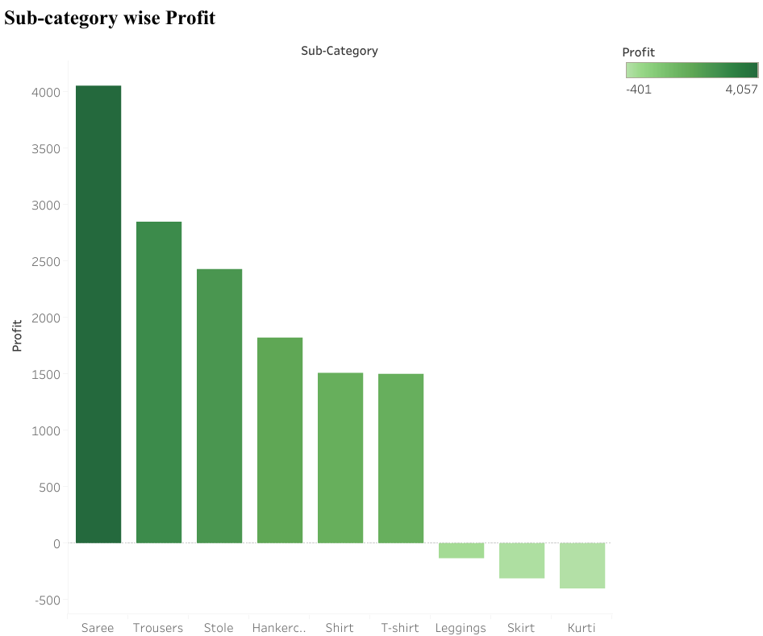

Slide 6
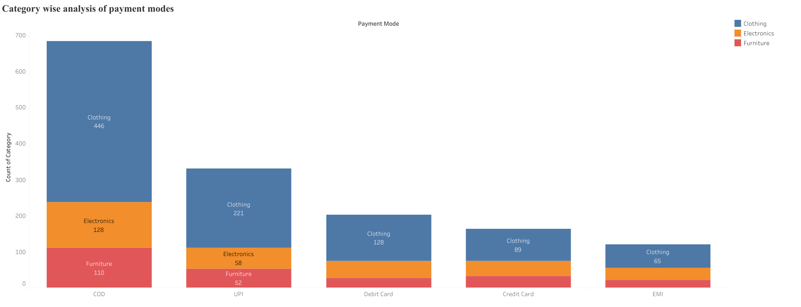

Slide 7
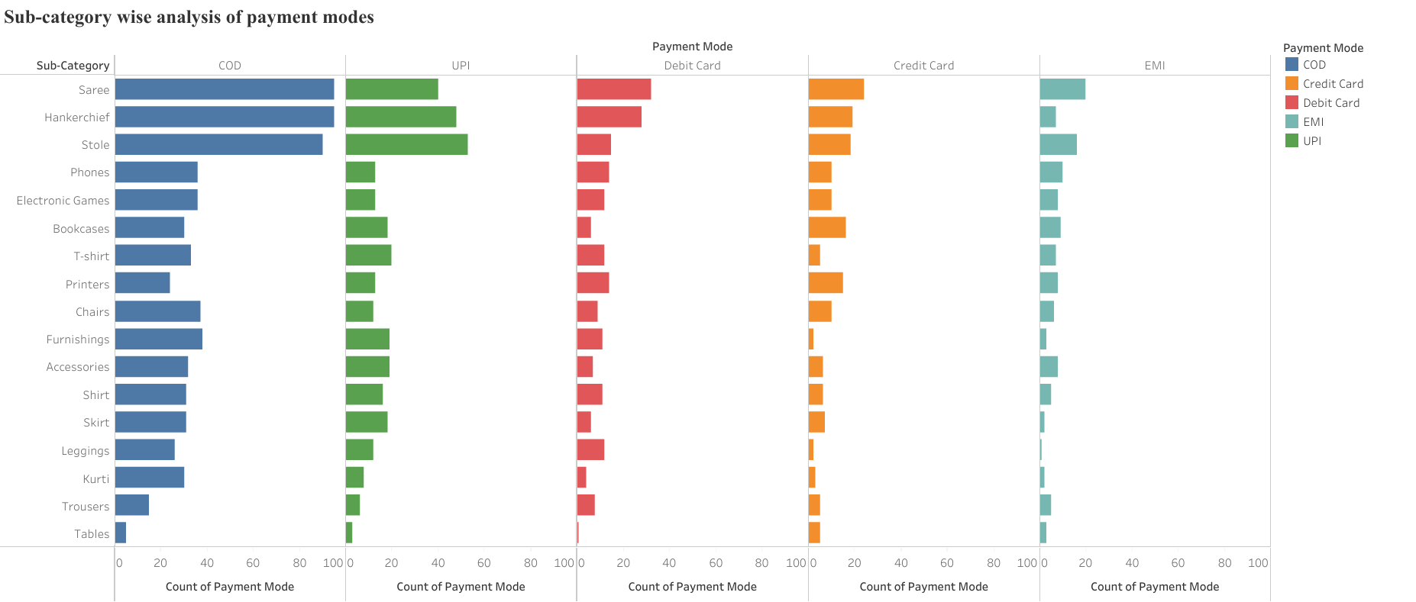

Slide 8
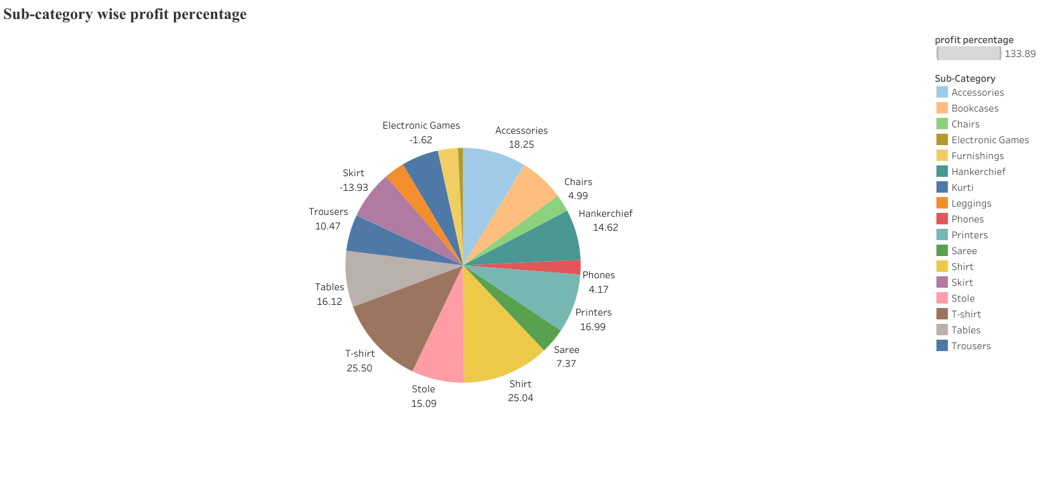

Slide 9


Slide 10


Slide 11


Slide 12
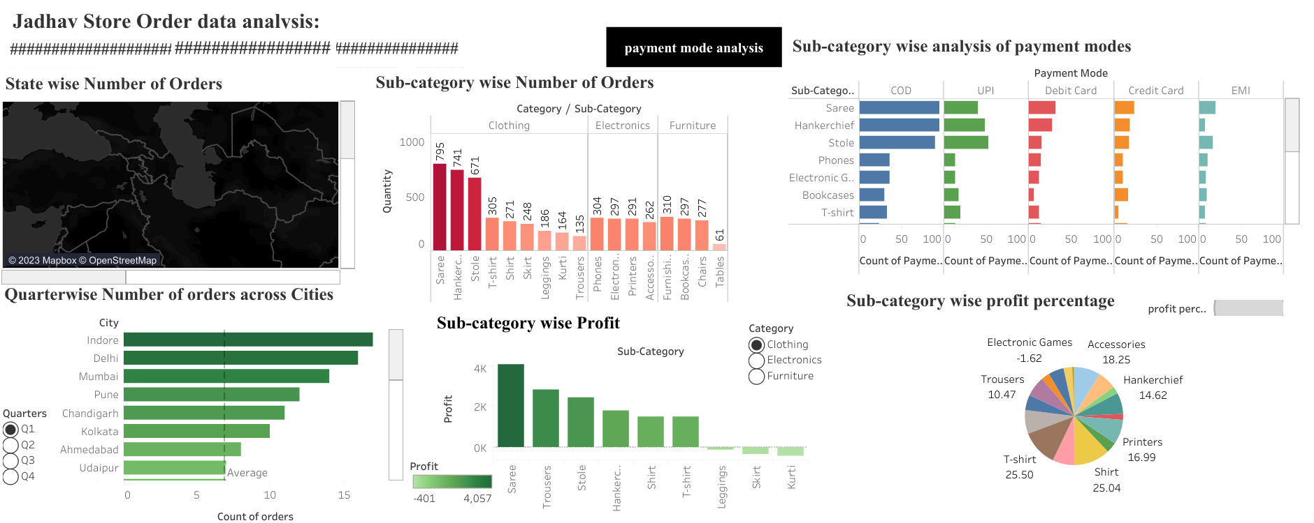

Slide 13
INSIGHTS:
Maharashtra followed by MP has ordered more number of items across country.
Indore, Mumbai, Chandigarh, Pune, Delhi, Kolkata, Bhopal and Bangalore has ordered average or more number of items in all quarters of year.
Category wise Clothing items are sold more followed by electronics and lastly furniture.
COD is preferred more followed by UPI.

Slide 14
INFERENCES:
Category wise Clothing orders are received more hence we can stock them more.
Printers, bookcases and sarees are top three items giving more profit hence they can be stock more as well.
COD is more preferred followed by UPI payments while EMI options are least preferred hence given COD as payment mode might increase sell.
Items like leggings, skirt, electronic games, furnishings are giving major loss hence in future we can stock them less.
Profit percentages of shirt, T-shirts, accessories, printers are good hence, we can stock them more as they can increase overall profit margin of the store.

